Slide 1
Use Case Diagram

Slide 2
Use Case Diagram
A Use Case Diagram is a visual representation that illustrates the interactions between users (actors) and a system.
It captures the functional requirements of a system, showing how different users involve with various use cases, or specific functionalities, within the system.
Use case diagrams provide a high-level overview of a system’s behavior, making them useful for stakeholders, developers, and analysts to understand how a system is intended to operate from the user’s perspective, and how different processes relate to one another.
They are crucial for defining system scope and requirements.

Slide 3
What is a Use Case Diagram in UML?
A Use Case Diagram is a type of Unified Modeling Language (UML) diagram that represents the interaction between actors (users or external systems) and a system under consideration to achieve specific goals.
It provides a high-level view of the system’s functionality by illustrating the various ways users can interact with it.

Slide 4
Purpose of Use Case Diagram
Use case diagrams are typically developed in the early stage of development and people often apply use case modeling for the following purposes:
Specify the context of a system
Capture the requirements of a system
Validate a systems architecture
Drive implementation and generate test cases
Developed by analysts together with domain experts

Slide 5
When to apply Use Case Diagram?
Use case diagrams are useful in several situations. Here’s when you should consider using them:
When you need to gather and clarify user requirements, use case diagrams help visualize how different users interact with the system.
If you’re working with diverse groups, including non-technical stakeholders, these diagrams provide a clear and simple way to convey system functionality.
During the system design phase, use case diagrams help outline user interactions and plan features, ensuring that the design aligns with user needs.
When defining what is included in the system versus what is external, use case diagrams help clarify these boundaries.

Slide 6
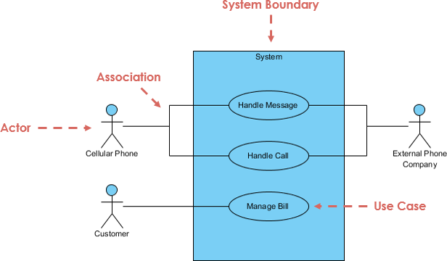
A standard form of use case diagram is defined in the Unified Modeling Language as shown in the Use Case Diagram example below:

Slide 7
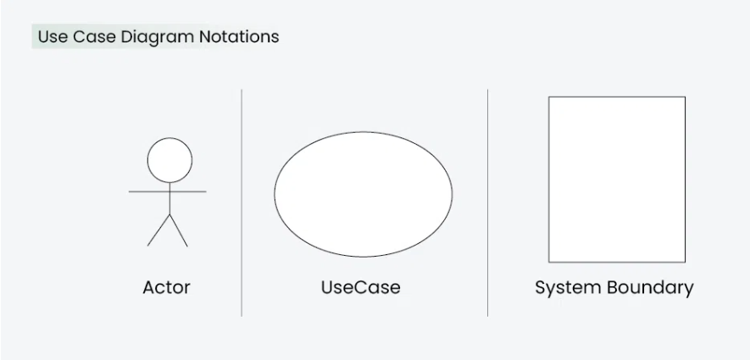
Use Case Diagram Notations UML notations provide a visual language that enables software developers, designers, and other stakeholders to communicate and document system designs, architectures, and behaviors in a consistent and understandable manner.

Slide 8
Actors
Actors are external entities that interact with the system.
These can include users, other systems, or hardware devices.
In the context of a Use Case Diagram, actors initiate use cases and receive the outcomes.
Proper identification and understanding of actors are crucial for accurately modeling system behavior.

Slide 9
Actors
Someone interacts with use case (system function).
Named by noun.
Actor plays a role in the business
Similar to the concept of user, but a user can play different roles
For example:
A prof. can be instructor and also researcher
plays 2 roles with two systems
Actor triggers use case(s).

Slide 10
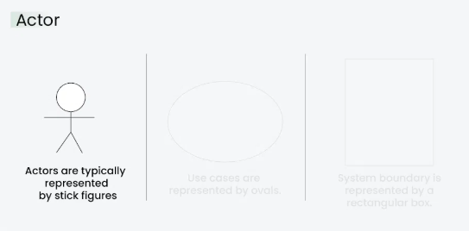
Actors
Actor has a responsibility toward the system (inputs), and Actor has expectations from the system (outputs).

Slide 11
Use Cases
Use cases are like scenes in the play. They represent specific things your system can do. In the online shopping system, examples of use cases could be “Place Order,” “Track Delivery,” or “Update Product Information”.
Use cases are represented by ovals.
System function (process - automated or manual)
Named by verb + Noun (or Noun Phrase).
i.e. Do something
Each Actor must be linked to a use case, while some use cases may not be linked to actors.

Slide 12
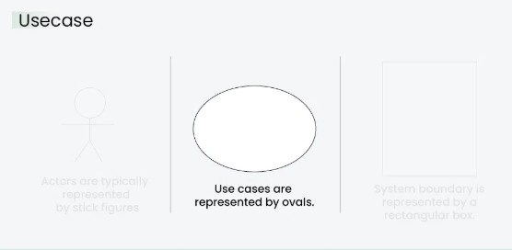
Use Cases

Slide 13
System Boundary
The system boundary is a visual representation of the scope or limits of the system you are modeling.
It defines what is inside the system and what is outside.
The boundary helps to establish a clear distinction between the elements that are part of the system and those that are external to it.
The system boundary is typically represented by a rectangular box that surrounds all the use cases of the system.
The purpose of system boundary is to clearly outlines the boundaries of the system, indicating which components are internal to the system and which are external actors or entities interacting with the system.

Slide 14
System Boundary
For large and complex systems, each module may be the system boundary.
For example, for an ERP system for an organization, each of the modules such as personnel, payroll, accounting, etc. can form a system boundary for use cases specific to each of these business functions.
The entire system can span all of these modules depicting the overall system boundary.

Slide 15
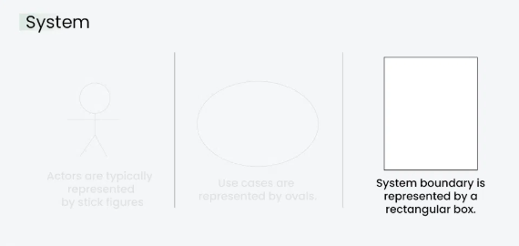

Slide 16
Use Case Diagram Relationships
Association Relationship
The Association Relationship represents a communication or interaction between an actor and a use case.
It is depicted by a line connecting the actor to the use case.
This relationship signifies that the actor is involved in the functionality described by the use case.

Slide 17
Association Relationship
Example: Online Banking System
Actor: Customer
Use Case: Transfer Funds
Association: A line connecting the “Customer” actor to the “Transfer Funds” use case, indicating the customer’s involvement in the funds transfer process.

Slide 18
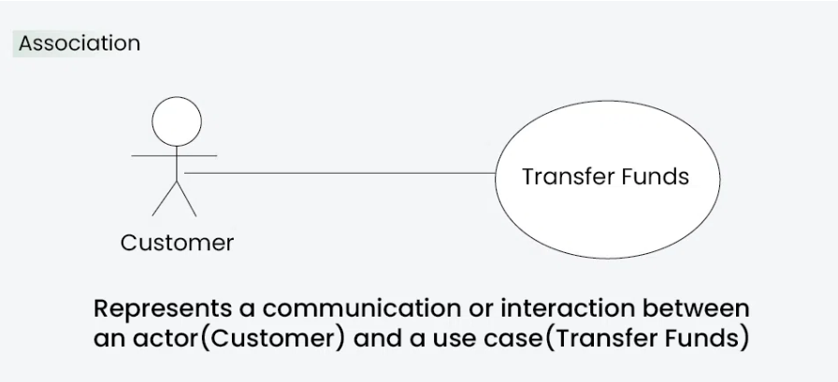

Slide 19
2. Include Relationship
The Include Relationship indicates that a use case includes the functionality of another use case. It is denoted by a dashed arrow pointing from the including use case to the included use case. This relationship promotes modular and reusable design.
The include relationship adds additional functionality not specified in the base use case. The <<Include>> relationship is used to include common behavior from an included use case into a base use case in order to support the reuse of common behavior.

Slide 20
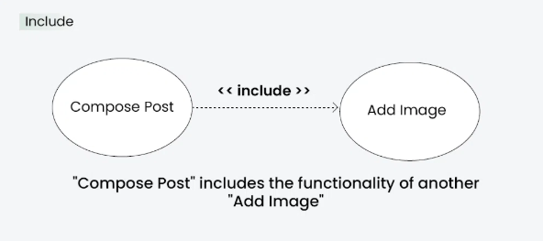
Example: Social Media Posting
Use Cases: Compose Post, Add Image
Include Relationship: The “Compose Post” use case includes the functionality of “Add Image.” Therefore, composing a post includes the action of adding an image.

Slide 21
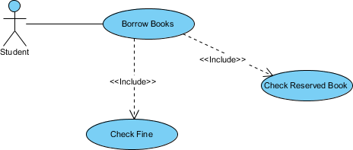

Slide 22
3. Extend Relationship
The Extend Relationship illustrates that a use case can be extended by another use case under specific conditions.
It is represented by a dashed arrow with the keyword “extend.” This relationship is useful for handling optional or exceptional behavior.
The extend relationships are important because they show optional functionality or system behavior.
The <<extend>> relationship is used to include optional behavior from an extending use case in an extended use case.

Slide 23
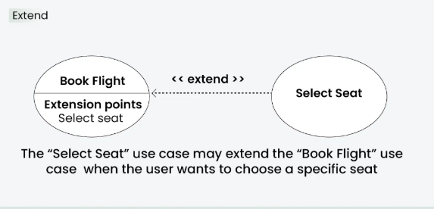
Example: Flight Booking System
Use Cases: Book Flight, Select Seat
Extend Relationship: The “Select Seat” use case may extend the “Book Flight” use case when the user wants to choose a specific seat, but it is an optional step.

Slide 24

Another Example

